Slide 1

Entity Framework
3 – Coding Data Operations

Slide 2
Overview
Logging
Table-based CRUD Operations
Native queries and mapping to objects
Transactions
Relationships and Lazy Loading
Paging
Async

Slide 3
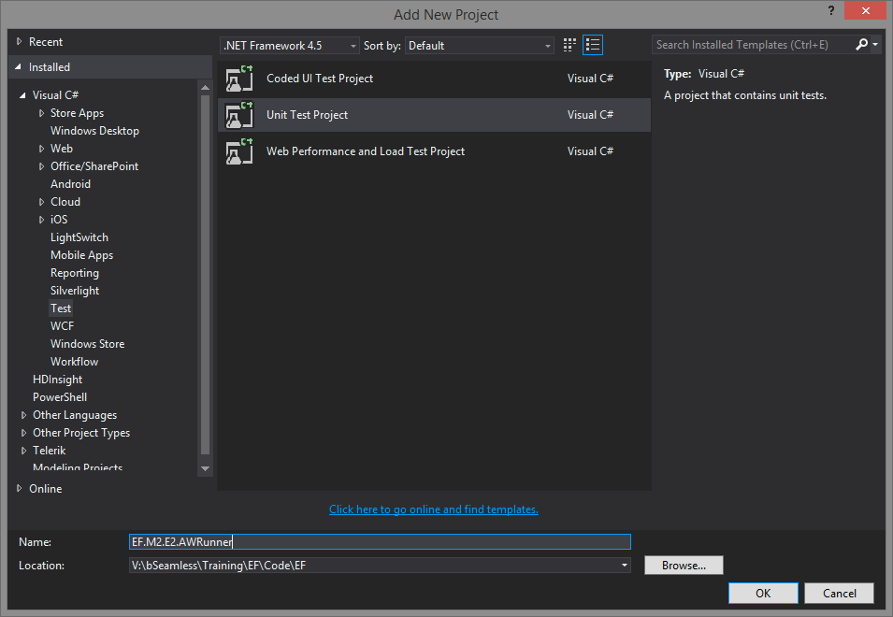
Create a Runner

Slide 4
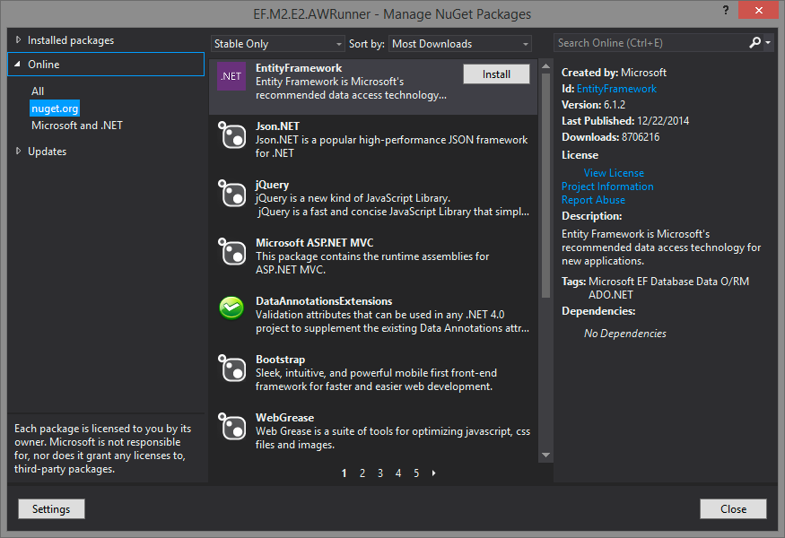
Reference EF

Slide 5
Logging
The Context Database.Log property
To the console or textwriter
DatabaseLogFormatter
Set it in a derivation of DbConfiguration
To Nlog with interception
IDbCommandInterceptor
https://msdn.microsoft.com/en-us/data/dn469464.aspx

Slide 6
Table based CRUD
Get entities in a table
Add entities
Delete entities
Update

Slide 7
Basic Query 1:M

Slide 8
M:M
No Payload model
Payload model

Slide 9
Lazy Loading

Slide 10
Eager Loading
.Include().Select()

Slide 11
Load a complete object graph

Slide 12
Execute aggs on related entities 5-10

Slide 13
Diagramming
Create new and add entities
Removing items from a diagram
Create new diagram from selected entities

Slide 14
Update model from DB
Add a column to a table
Add new table
Update model from db option
Designer will not alter or remove existing properties
Validate model will show this
Change property type manually

Slide 15
Stored procedures
Show that function parameters are created
Results are complex types
Can remove to map to another entity
Show how to reference but not create functions
Show how to map functions like delete to stored procs

Slide 16
Enum support
Requires .net 4.5
Change ship method property to enum
Add new enum type
Specify enum values
Land, sea, air, …
Change type of ship method to the enum
Show how to use an existing enum
Enum type name must match and use reference

Slide 17
Geo modeling
Geolocation
Add it to the database table

Slide 18
Keys on views
No primary and no non-nullable, then not imported

Slide 19
Demo

Slide 20
Summary

